Slide 1


RSRS
(Resistance Support Relative Strength)
Trade Strategy And Optimization of Market State Indicators
Group 6
1155166336
1155164917
1155162320
1155162325
1155169203
ZHANG Xincong
HUANG Yijing
GUO Zhongyuan
MA Ziqing
LIU Luyao

Slide 2

Expectations!
Returns!
What’s the future trend？

Slide 3

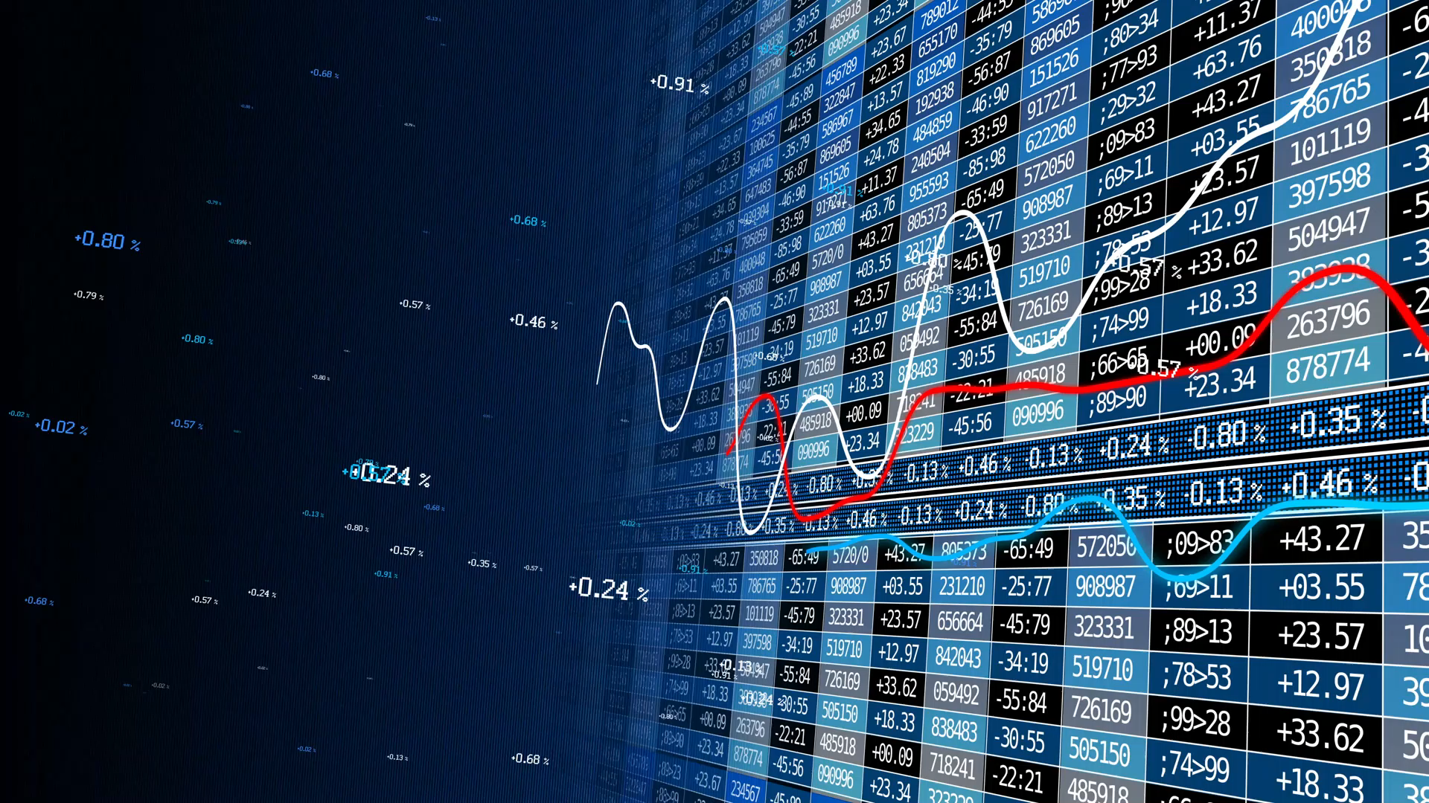

1&2
Background、Research
&
Timing Logic Implementation
Speaker : MA,Ziqing

Slide 4










Introduction
Background & Research
Research Background、 Purpose & Significance
Target
RSRS Strategy
Bull & Bear Indicator
Timing Model
Literature review
$$×$$
Research Content
Timing logic implementation

Slide 5



Research Purpose and Siginificance
RSRS
How to deal with the impact of technical indicators when the market style changes？
One solution is to face it head-on, devise a logic that can predict to a certain extent whether the future market will be trending or fluctuating.
Another solution is to bypass him. When constructing indicators, the timing logic behind it does not rely on the assumption of current market conditions.
Purpose
The purpose of this study is to maximize the ability to predict the future market, reduce investment risks, and find a timing logic that is feasible in both trending and volatile markets .
First,to determine whether the market outlook is a trend market or a volatile market
second, to determine the current support and resistance levels.
RSRS
“Resistance point”& “Support point”
Therefore, we can think of resistance and support levels as variables.
It is a variable, two main concepts - expectation and variance.
when we can compare the strength of resistance and support, then a natural timing logic is:
if the current market support level is stronger than the resistance level, then the market is more like a bull market;
if the current market support level strength Less than the strength of the resistance level, then the market is more inclined to develop into a bear market.
This logic does not need to judge whether the current market is falling, fluctuating or rising!
Siginificance

Slide 6
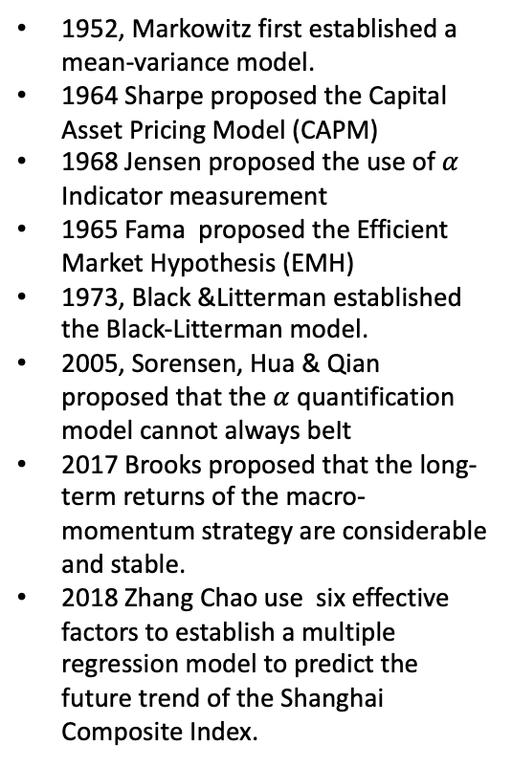
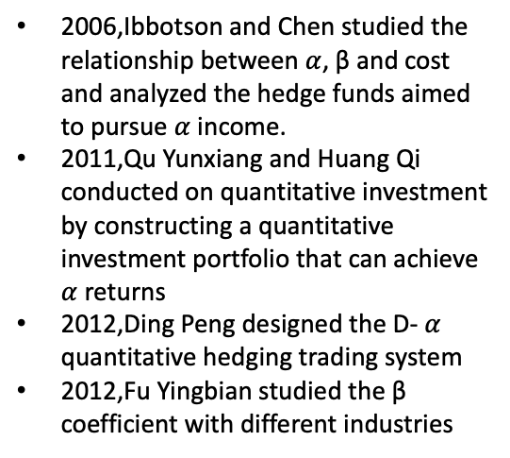
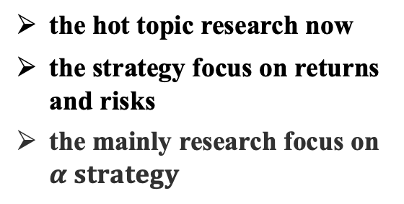
Introduction
Literature Review
Literature Review
Based on macro-fundamental economic indicators
Based on the mental of hedging of returns and risks.
Based on market price and volume information
early Traditional Timing Manner
the hot topic research now
the strategy focus on returns and risks
the mainly research focus on $α strategy$
more direct response to the market
the analysis results are closer to the actual market phenomenon,
the strategy win rate is higher.
1952, Markowitz first established a mean-variance model.
1964 Sharpe proposed the Capital Asset Pricing Model (CAPM)
1968 Jensen proposed the use of $α$ Indicator measurement
1965 Fama proposed the Efficient Market Hypothesis (EMH)
1973, Black &Litterman established the Black-Litterman model.
2005, Sorensen, Hua & Qian proposed that the $α$quantification model cannot always beIt
2017 Brooks proposed that the long-term returns of the macro-momentum strategy are considerable and stable.
2018 Zhang Chao use six effective factors to establish a multiple regression model to predict the future trend of the Shanghai Composite Index.
2006,Ibbotson and Chen studied the relationship between $α$, β and cost and analyzed the hedge funds aimed to pursue $α$income.
2011,Qu Yunxiang and Huang Qi conducted on quantitative investment by constructing a quantitative investment portfolio that can achieve $α$ returns
2012,Ding Peng designed the D- $α$ quantitative hedging trading system
2012,Fu Yingbian studied the β coefficient with different industries
2012,Moskowitz et al. (2012) elaborated on a typical representative of trend-following timing strategies-Time Series Momentum

Slide 7
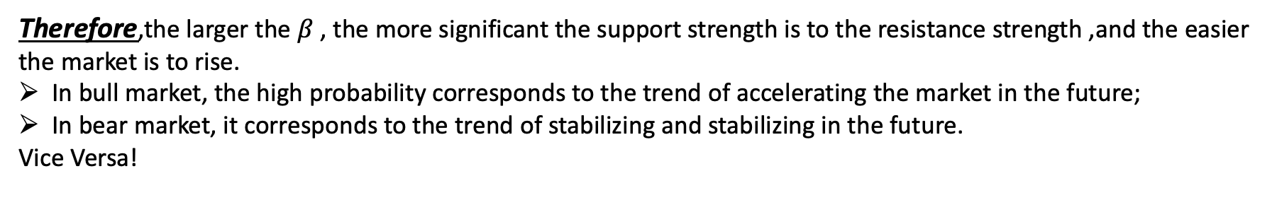
Research Content & Methods
RSRS & Proxy indicator construction
RSRS
Market Status | Resistance Strength > Support Strength | Support Strength > Resistance Strength
Bull Market | The upward momentum is exhausted, or it will peak | Rising momentum is strong, accelerating the rise
Volatile market | Short-term sentiment peaked, about to pull back | Short-term sentiment bottoms out and is about to rebound
Bear Market | Fears are strong, the decline accelerates | The downward momentum is exhausted, or it will bottom out
Content
Proxy indicator construction - Extract information from the volume and price data
Do not touch the limit-up or limit-down price, it is the resistance and support
focus on the alignment of market participants with resistance and support levels
∆(high)/ ∆(low) to describe the relative strength of the support level and the resistance level, that is, when the lowest price changes by 1, the range of the highest price change.
Due to the noise , we consider the recent N (low, high) data points to get the relative change degree of the highest and lowest prices with relatively high signal-to-noise.
Methods
$${high}_{t}=α+β∗{low}_{t}+ε,ε\sim N\left(0,σ\right),tε\left\{0,1,2,…,N−1\right\}$$
Therefore,the larger the $β$ , the more significant the support strength is to the resistance strength ,and the easier the market is to rise.
In bull market, the high probability corresponds to the trend of accelerating the market in the future;
In bear market, it corresponds to the trend of stabilizing and stabilizing in the future.
Vice Versa!

Slide 8
Research Content & Methods
RSRS & Proxy indicator construction
RSRS
The daily highest price and the daily lowest price are used as support and resistance, and the relative strength of the change of the highest price and the lowest price is used as the specific price threshold of support and resistance.
First, the strength of support and resistance is measured by the magnitude of the change in the highest price when the lowest price changes by 1 unit;
Second, the regression is performed with the sequence of the highest price and the lowest price in the same time interval. specific indicators.
In order to reduce volatility to achieve better results,the slope value is standardized and the fitting effect is considered.
The decision coefficient (R2 in the regression result)is weighted by the standard score
The right-biased standard score with significant effect is used to determine the buying time of bottom hunting .
Specific
Application
Idea
$${high}_{t}=α+β∗{low}_{t}+ε,ε\sim N\left(0,σ\right),tε\left\{0,1,2,…,N−1\right\}$$

Slide 9
3 Modelling
Construct the Relative Strength of Resistance Support (RSRS) indicator
Speaker : LIU,Luyao

Slide 10
Construct RSRS indicator
1. Take the highest and lowest price sequences of the previous N days.
2. Perform OLS linear regression on the model of equation with two columns of data.
3. Regard the fitted beta value as the RSRS slope indicator value for that day.
Slope Indicator
1. Take the slope time series of the previous M day.
2. Calculate the standard score of that day by using this sample.
3. Use the calculated standard score z as the standard score of RSRS on that day.
Standard Score Indicator

Slide 11

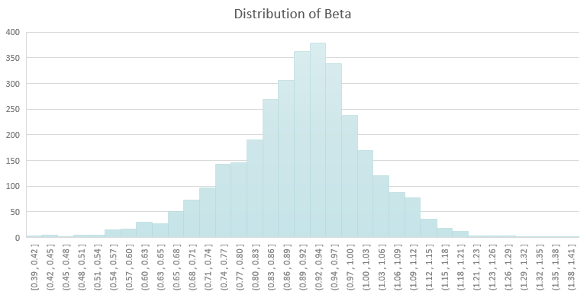
Slope Indicator
RSRS Threshold
S1=1.0 S2=0.8
Statistics | Statistical value
mean | 0.8971181742
std | 0.1204043879
min | 0.3936107973
Skewness | -0.321778843
Kurtosis | 0.9543830466
1. Calculate the RSRS slope.
2. If the slope is greater than 1, we take a long position.
3. If the slope is less than 0.8, we take a short position.
Standard Score Indicator
N=18 M=800 S=0.85
1. Calculate the standard score based on the slope (parameters N=18, M=800).
2. If the standard score is greater than S (parameter S=0.85), we take a long position.
3. If the standard score is less than -S, we take a short position.

Slide 12

Performance on HS300
Statistics | Slope Strategy | Standard Score Strategy
Annualized rate of return | 18.70% | 25.31%
Maximum drawdown | 23.87% | 27.06%
The total number of days of open positions | 1381 | 1867
Number of transactions | 49 | 32
Number of days of profit | 737 | 1005
Number of days of loss | 692 | 893
Average yield (per trade) | 2.62% | 5.81%
Profitability (per trade) | 6.58% | 10.08%
Loss ratio (per trade) | 2.47% | 3.16%

Slide 13

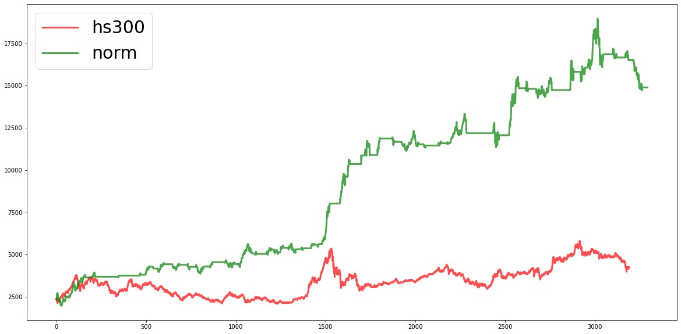
Optimal Factor:M=900 N=18 threshold=0.95
Perform of norm
method | N | M | threshold | rtn | drawdown
norm | 18 | 900 | 0.85 | 5.35 | 0.1168
 | 18 | 900 | 0.80 | 5.04 | 0.1066
 | 18 | 900 | 0.95 | 4.84 | 0.1453
 | 18 | 900 | 0.90 | 4.75 | 0.1454
Figure 4. Comparison of trading with “norm” method and hs300 itself

Slide 14
4 Optimization
Modify & Right method
Speaker : GUO,Zhongyuan

Slide 15






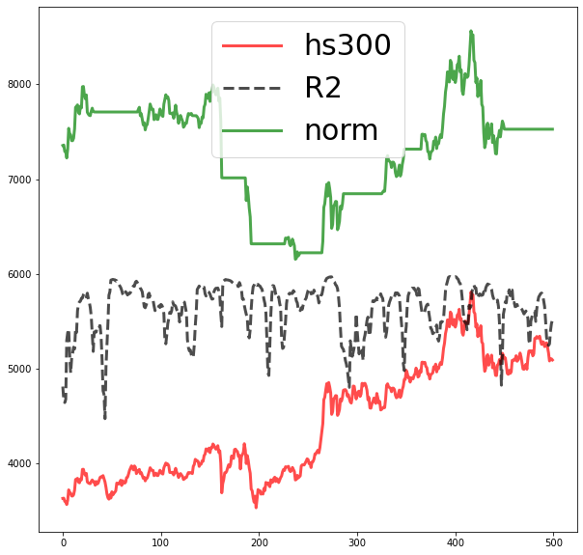
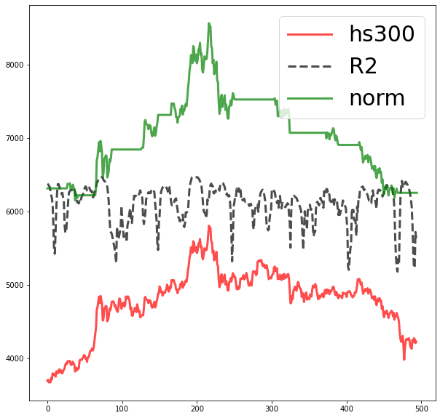

RSRS Optimization
There still exist some issues…
Issue
current strategy did not perform well in a bear market
Details
mistakenly judge that the decline is about to stop, and so try to buy at the bottom
Example
Example
Figure 5. Continued losses when hs300 fluctuates and rises
Figure 6. Continued losses when hs300 continues to fall

Slide 16

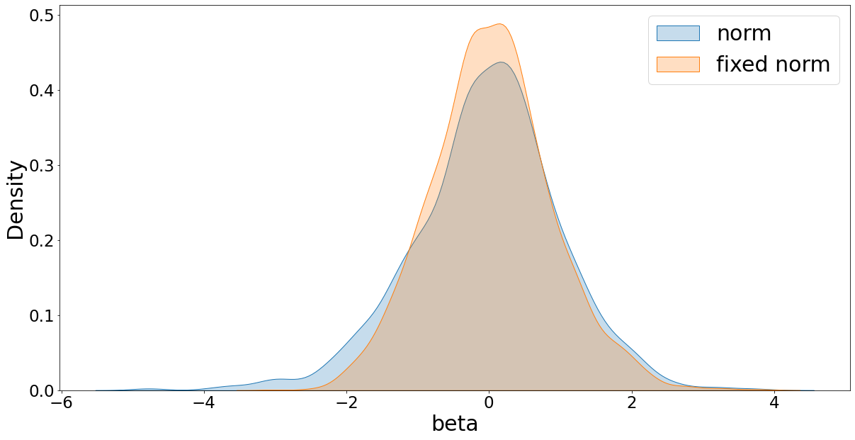
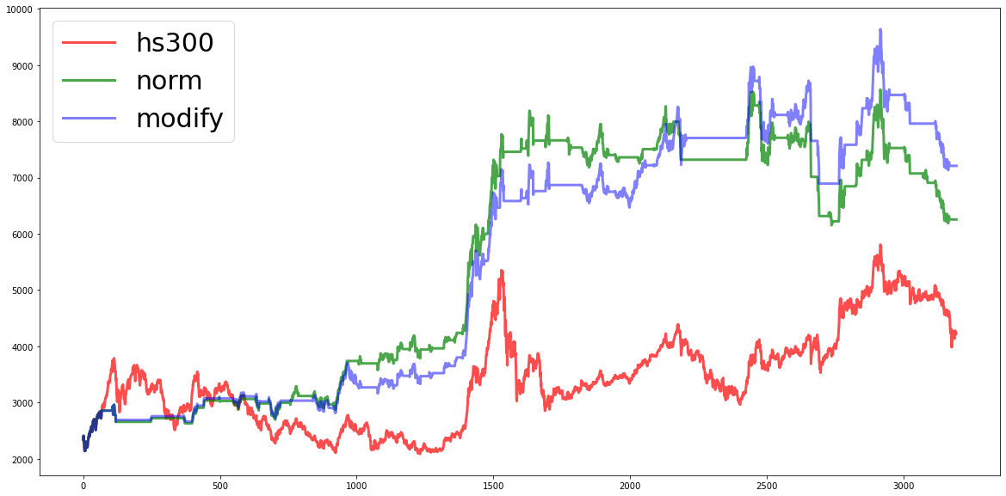



Optimization: modify
We use linear regression, when the fitting is not good, it will give an inaccurate signal
Figure 7. Distribution of norm and modify
In linear regression, $R^{2}$indicates whether the result is good
Statistics
name | mean | std | skewness | kurtosis
norm | -0.0205 | 1.0496 | -0.4153 | 1.1750
modify | 0.0477 | 0.8515 | 0.1683 | 0.4513
$$R^{2}=1− \frac{residual SS}{total SS}$$
Figure 8. Comparison of trading with “norm”“modify” and hs300 itself
We use the squared value of $R^{2}$ and the standard score to get the modify standard score
$$beta_{modfy}=beta_{norm}∗R^{2}$$

Slide 17
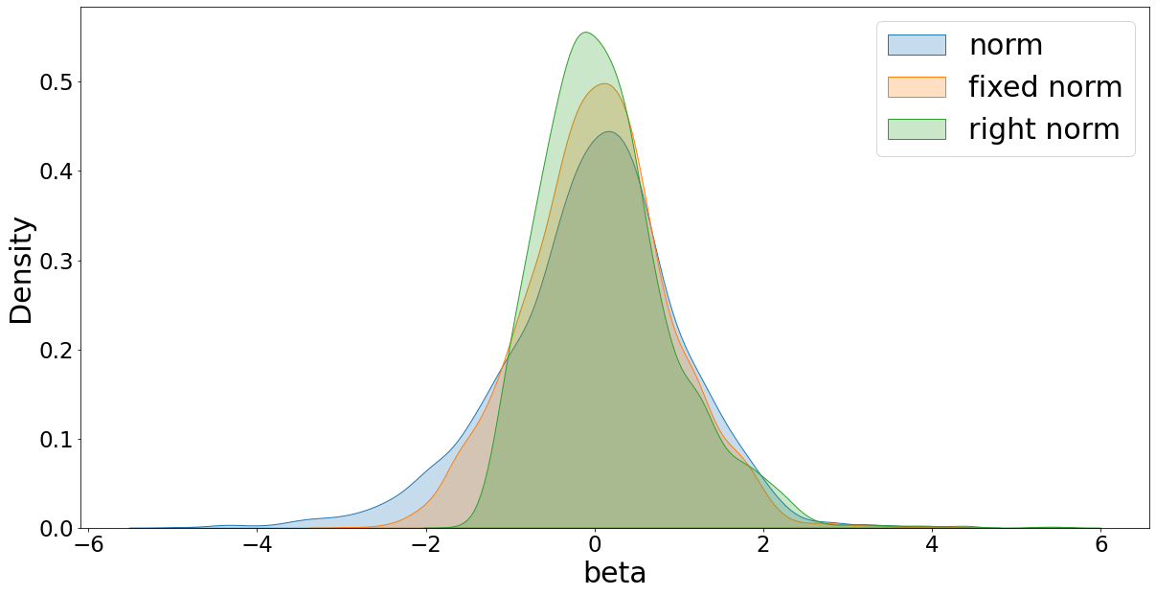
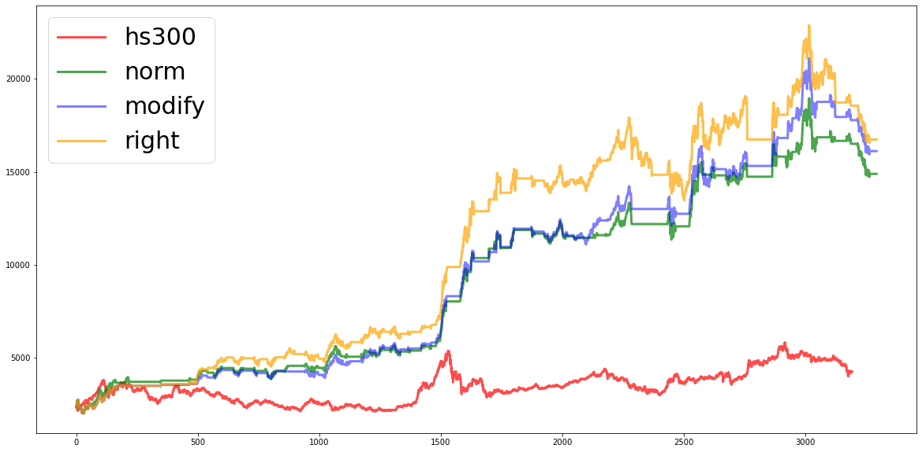

Optimization: right
Figure 9. Distribution of norm, modify and right
(*𝑹^𝟐) performs better, see that he left tail of the distribution decreases
What if we shorten the left tail again
beta | mean | std | skewness | kurtosis
norm | -0.0205 | 1.0496 | -0.4153 | 1.1750
modify | 0.0477 | 0.8515 | 0.1683 | 0.4513
right | 0.1424 | 0.7921 | 1.0800 | 2.5948
Figure 10. Comparison of trading with “norm”“modify”“right” and hs300 itself
$$beta_{right}=beta_{modify}∗beta$$
We get a right-skewed beta distribution

Slide 18





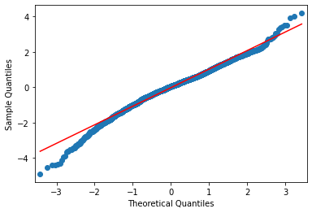
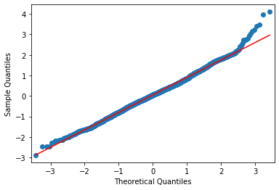
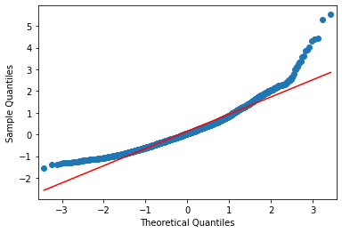
Optimize Summary
norm
modify
right
Figure 11. QQplot of norm, modify and right method
Grid search for [N M threshold], best performance of all methods
method | N M th | AR | CAR | Base AR | Base CAR | Rtn/trade | alpha | beta | Trades | Win rate | Hold days | Profit days | Profit rate | Loss rate | Profit/loss | Volatility | drawdown | Sharp ratio | Information ratio
Norm | 16,900, 0.95 | 0.2164 | 4.6412 | 0.0921 | 1.1776 | 0.0348 | 0.1243 | 0.3646 | 46 | 0.6304 | 1417 | 764 | 0.0698 | 0.0286 | 2.4380 | 0.1390 | 0.2264 | 0.2884 | 10.6272
Modify | 16, 900, 0.90 | 0.2339 | 5.4001 |  |  | 0.0411 | 0.1418 | 0.4264 | 42 | 0.6666 | 1643 | 884 | 0.0741 | 0.0298 | 2.4809 | 0.1503 | 0.2475 | 0.3705 | 12.8201
Right | 18, 800, 0.85 | 0.2531 | 6.3329 |  |  | 0.0581 | 0.1609 | 0.4680 | 32 | 0.6562 | 1867 | 1005 | 0.1008 | 0.0316 | 3.1885 | 0.1589 | 0.2706 | 0.4536 | 15.0433
The optimization has improved the predictability and income

Slide 19
5 Introduction to Market State Indicator
Speaker : ZHANG, Xincong

Slide 20


Common Market Trend Indicators
Volatility
Volatility is the standard deviation of market return rate, which measures the fluctuation of return rate and is the most commonly used risk measure.
For the stock market, volatility tends to be higher when market goes down.
Figure 12. CSI300 Close Price and Volatility

Slide 21
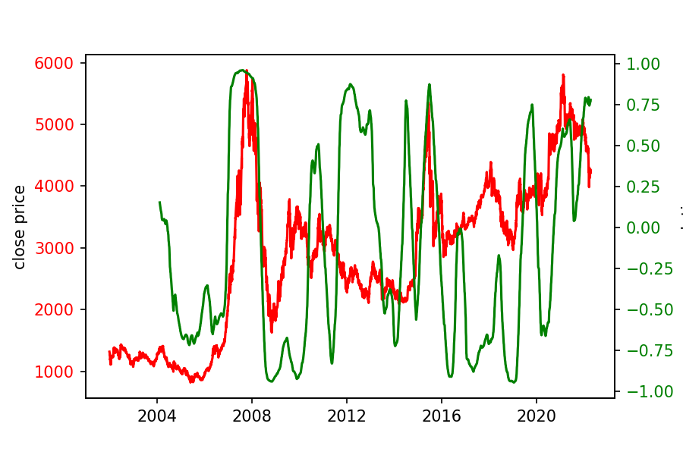
Common Market Trend Indicators
Volatility
There is an obvious correlation and very similar volatility between the one-year lag volatility and the close price of CSI 300.
Figure 13. correlation coefficient between the one-year lag volatility and the daily closing price of CSI 300
Volatility

Slide 22
Common Market Trend Indicators
2. Turnover Rate
Turnover rate is the frequency of stock turnover in the market within a certain period of time, which is one of the indicators reflecting the strength of stock liquidity and trading activity.
The rise and fall in turnover rates tend to have a strong correlation with the stock market itself, as investors become more enthusiastic about trading when market begins to go up.
Figure 14. Close Price and Turnover Rate

Slide 23
Common Market Trend Indicators
2. Turnover Rate
We use the method of moving average to investigate the trend change of turnover rate over a period of time.
Figure 15. Close Price and Turnover Rate

Slide 24
Table Market State Summary
Summary
Volatility | Turnover Rate | Market State
rise | fall | Bear
rise | rise | Bull
fall | rise | Bull Beginning or After Bear
fall | fall | Volatile Market
Figure 16. Close Price, 120-day Volatility and 250-day Turnover Rate chart
In the research, we find that the market can be well classified by means of volatility and turnover rate, and both bull and bear markets have clear combination characteristics corresponding to them.

Slide 25


Market State Indicator
What if we combine volatility and turnover rate…
$$indicator= \frac{Volatility}{Turnover Rate}$$
Figure 17. CSI300 Close Price and Market State Indicator

Slide 26

Market State Indicator
What if we combine volatility and turnover rate…
$$indicator= \frac{Volatility}{Turnover Rate}$$
Figure 17. CSI300 Close Price and Market State Indicator
Market state Indicator
has a relatively obvious negative correlation with the market status
has smaller fluctuation
gets rid of the lag of the moving average strategy.

Slide 27
5 Optimization and Result
Speaker : HUANG, Yijing

Slide 28


Optimization Based on Close Price Trends
In the back test, we found that several large losses occurred in the bear market, in order to avoid the wrong open signal in the bear market, we added the 20-day closing price MA as another signal.
Market state indicator is the optimization method.
1. Calculate RSRS index buy and sell signals.
1. Calculate RSRS index buy and sell signals.
2. If the indicator sends a buy signal and meets the requirement that MA(20) of the previous day is greater than MA(20) 10 days ago, buy.
2. If the indicator sends a buy signal and meets the requirement that the market state indicator the previous day is less than the market state indicator 10 days ago, buy.
3. If the indicator sends a sell signal, sell.
3. If the indicator sends a sell signal, sell.
$$signal= \left\{\begin{aligned}&1, RSRS>threshold and {MA}_{t}\left(20\right)>{MA}_{t−10}\left(20\right) \\ &0,RSRS<threshold\end{aligned}\right.$$
$$signal= \left\{\begin{aligned}&1, RSRS>threshold and {indicator}_{t}<{indicator}_{t−10} \\ &0,RSRS<threshold\end{aligned}\right.$$

Slide 29
Optimization Based on Close Price Trends
Figure 18. Trading Strategy Optimization and Result - Close Price

Slide 30

Optimization Based on Close Price Trends
Table Trading Strategy Optimization and Result - Close Price
Indicators | RSRS | RSRS+MA (10) | RSRS + Market indicator
Annualized rate of return | 25.31% | 14.25% | 17.87%
HS300 annualized rate of return | 9.21% | 9.21% | 9.21%
Accumulated rate of return | 633.29% | 224.15% | 327.06%
HS300 accumulated rate of return | 117.77% | 117.77% | 117.77%
Rate of return (per trade) | 5.81% | 9.04% | 10.19%
alpha | 0.16 | 0.05 | 0.087
beta | 0.47 | 0.54 | 0.50
Trade times | 32 | 13 | 14
Win rate | 65.63% | 61.54% | 64.29%
Position day | 1867 | 1975 | 1993
Win day | 1005 | 1077 | 1088
Loss day | 893 | 911 | 919
Yield rate (per trade) | 10.09% | 17.59% | 16.37%
Loss rate (per trade) | 3.16% | 8.04% | 3.72%
Profit and loss ratio | 3.19 | 2.19% | 4.40
Volatility | 15.90% | 16.89% | 16.20%
Max drawback | 27.07% | 24.71% | 25.69%
Information rate | 15.04 | 5.13 | 8.46
The number of transactions and costs brought by transactions are reduced, and the rate of return (per trade) is significantly increased.

Slide 31
Optimization Based on Turnover Rate Trends
In addition to the daily closing price, the state of the market can also be inferred from the turnover rate. According to the previous analysis, when the turnover rate rises, it is generally a bull market, and when the turnover rate falls, it is generally a bear market.
1. Calculate RSRS index buy and sell signals.
1. Calculate RSRS index buy and sell signals.
2. If the indicator sends a buy signal and the correlation between the turnover rate and the corrected standard score of the previous 10 days is positive, buy.
2. If the indicator sends a buy signal and the correlation between the market state indicator and the corrected standard score of the previous 10 days is positive, buy.
3. If the RSRS sends a sell signal, sell.
3. If the indicator sends a sell signal, sell.
$$signal= \left\{\begin{aligned}&1, RSRS>threshold and Corr\left(turnover rate, RSRS\right)>0 \\ &0,RSRS<threshold\end{aligned}\right.$$
$$signal= \left\{\begin{aligned}&1, RSRS>threshold and Corr\left(indicator, RSRS\right)<0 \\ &0,RSRS<threshold\end{aligned}\right.$$

Slide 32
Optimization Based on Turnover Rate Trends
Figure 19. Trading Strategy Optimization and Result – Turnover Rate

Slide 33
Optimization Based on Close Price Trends
Table Trading Strategy Optimization and Result - Close Price
Indicators | RSRS | RSRS + turnover rate | RSRS + Market indicator
Annualized rate of return | 25.31% | 16.45% | 18.81%
HS300 annualized rate of return | 9.21% | 9.21% | 9.21%
Accumulated rate of return | 633.29% | 283.90% | 358.08%
HS300 accumulated rate of return | 117.77% | 117.77% | 117.77%
Rate of return (per trade) | 5.81% | 4.83% | 8.19%
alpha | 0.16 | 0.07 | 0.10
beta | 0.47 | 0.49 | 0.58
Trade times | 32 | 23 | 18
Win rate | 65.63% | 73.91% | 66.67%
Position day | 1867 | 1973 | 2229
Win day | 1005 | 1054 | 1199
Loss day | 893 | 942 | 1048
Yield Rate (per trade) | 10.09% | 8.52% | 14.06%
Loss Rate (per trade) | 3.16% | 7.71% | 5.90%
Profit and loss ratio | 3.19 | 1.10 | 2.38
Volatility | 15.90% | 15.86% | 17.42%
Max drawback | 27.07% | 30.06% | 29.53%
Information rate | 15.04 | 6.93 | 10.36
The number of transactions and costs brought by transactions are reduced, and the rate of return (per trade) is significantly increased.

Slide 34
Summary
In this research, we backtest the RSRS strategy and select the optimal threshold. The final backtest result shows rate of return can be significantly improved.
At the same time, modified standard score and right deviation standard score are used to improve the strategy. The results show that the right deviation standard score strategy can significantly improve the signal accuracy of RSRS strategy.
RSRS
In this study, we use the close price, turnover rate and the ratio of volatility and turnover rate as market state indicators respectively to optimize the RSRS strategy. All these indicators can significantly reduce the number of transactions and the cost of transactions.
Among the three indicators, the ratio of volatility to turnover rate is used as an indicator of market state, and the optimization effect is better.
RSRS strategy should be used in conjunction with optimization strategy since the return rate of signal system decreases after adding market state indicator.
Market State Indicator
Risk Warning: This study is based on historical data and may be affected by market volatility in the future.

Slide 35
Thanks!

